Slide 1
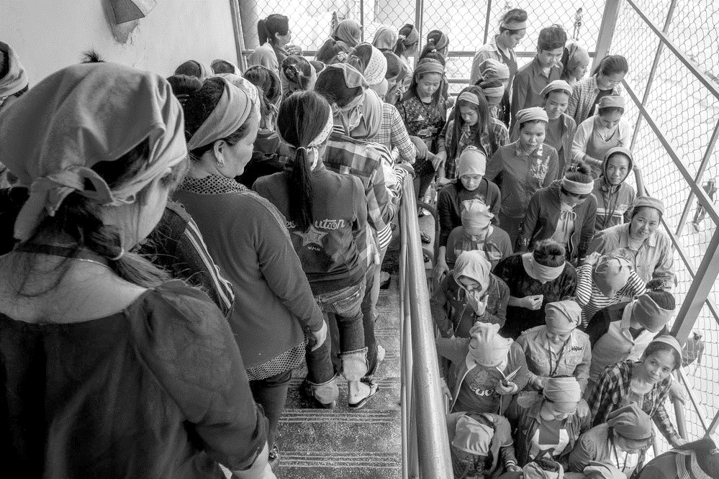
A World of Possibilities
Join IPPF’s Standing Committees to shape our Federation for the better.

Slide 2
It’s never been more urgent to advance and defend SRHR globally
You can help through applying for…
Policy Strategy and Investment Committee (PSIC)
Resource Allocation Technical Committee (RATC)
Membership Committee (MC)
Finance, Audit and Risk Committee (C-FAR).

Slide 3
Our Committees will be…
Skill-based, with members that have relevant expertise, competencies and experience
Min five, max 7 members, max 2 externals
Chaired by Trustee with max one other trustee as member
Internal members cannot be staff
At least 20% of members must be under 25
At least 50%
Across all Committees, representative of geographical diversity, ‘at risk’ and marginalised populations
Run in Arabic, English, French and Spanish, so it’s helpful if you speak more than one of these languages.

Slide 4
Policy Strategy and Investment Committee
Purpose
Mould IPPF’s strategy for Board review and approval
Support IPPF’s international policy development process and advocacy positions on issues of significance to the Federation
Consider the investments required from donors to deliver on IPPF Strategy

Slide 5
YOU CAN INFORM
IPPF’s Strategic Framework
Policy development
Advocacy positions
Positioning IPPF in key spaces
Investment priorities

Slide 6
You’ll have experience and interest in…
Policy and strategy formulation
SRHR and related fields
Evaluation, interfacing with donors and/or policy makers
Developing advocacy positions, particularly on sensitive issues.
Apply at: https://candidates.perrettlaver.com/vacancies/, reference 4770

Slide 7
Resource Allocation Technical Committee
Purpose
Review the quality and balance of IPPF’s programme portfolio and business cases
Optimize resource flows to MAs and collaborative partners
Review and evaluate IPPF’s Resource Allocation Model for unrestricted resources.

Slide 8
YOU CAN INFORM
The resource allocation funding formula
How to move to multi-annual funding model
Integration with restricted projects and locally generated funding
How the new model will be evaluated

Slide 9
You’ll have experience and interest in…
Resource allocation, such as:
large multi-annual and strategic funding mechanisms
onward granting
programming in SRHR and related fields
Development assistance
Funding models for non-governmental organizations.
You’ll be analytical and take a broad and balanced view across the Federation.
Apply at: https://candidates.perrettlaver.com/vacancies/, reference 4770

Slide 10
Membership Committee
Purpose
Consider the overall form of the IPPF membership and structure of the Federation
Review and recommend applications for membership
Approve standards and guidelines for accrediting Member Associations.

Slide 11
YOU CAN INFORM
Parameters for membership and collaboration/ partnership
Membership standards, guidelines and accreditation
How standards help MAs respond to community needs
Action when standards aren’t met
Arbitrate on conflict involving MAs

Slide 12
You’ll have experience and interest in…
Setting and applying membership standards
Interpreting and applying organizational rules and regulations
Law
Finance
Federated structures and partnership development
Organizational development, evaluation and performance.
You’ll understand how Member Associations deliver and enable services, youth engagement and advocacy.
Apply at: https://candidates.perrettlaver.com/vacancies/, reference 4770

Slide 13
Finance, Audit and Risk Committee
Monitor IPPF’s financial performance, ensuring financial integrity
Oversee risk management, ensuring effective internal control systems
Recommend the appointment of the external and internal auditors:
review their work
ensure timely and appropriate responses to findings and recommendations.
We need one more committee member, who must be under 25 at the time of appointment

Slide 14
YOU CAN INFORM:
A high standard of financial oversight
Financial resources are correctly controlled, invested and spent
Risk Management
A programme of annual external and internal audits
Implementation of the Safeguarding policy
Timely and appropriate responses to findings and recommendation

Slide 15
You’ll have experience and interest in…
Finance
Law
Investment
Audit
Risk management
Apply at: https://candidates.perrettlaver.com/vacancies/, reference 4770

Slide 16
Two new trustees
Internal MA Candidates
Applications from Caribbean, Latin America, East Asia, Oceania, Middle East, North Africa applications strongly encouraged
Skills lost – legal expertise, youth
Additional skills useful – experience of a Board outside of IPPF

Slide 17
What you will you gain
An incredible opportunity to shape the Federation
Influence how IPPF operates by giving the Board of Trustees advice and challenge
Advance your professional development by gaining experience at this global level
Develop new professional relationships and friendships with people of all nationalities and backgrounds.

Slide 18
How to apply
Apply at: https://candidates.perrettlaver.com/vacancies/, quoting reference 4770
CV
Letter of motivation
Completed skills matrix (from the link above)
Names and contact details of two references.
Applications can be made in Arabic, English, French or Spanish.
Apply by 12:00PM BST on 7 September.
The IPPF Nominations and Governance Committee review and shortlist applications. Interviews via video conference will take place 12-16 October.
Join a committee and you can influence IPPF and SRHR globally.

